Slide 1
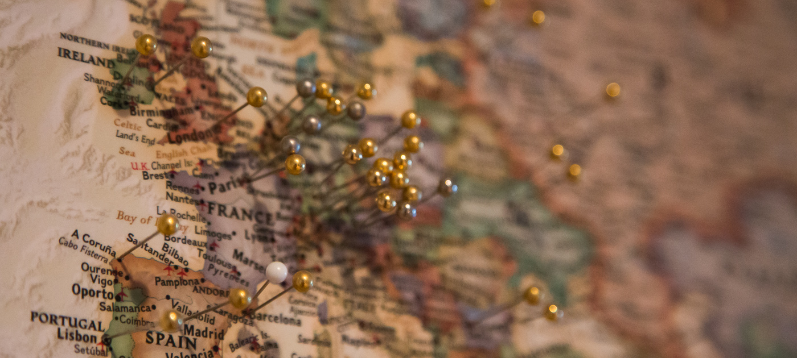
Topic: Political Geography
Aim: In What Ways Is the Political Landscape Formulated?
Do Now: QUIZ – Nation or State?

Slide 2
Political Geography
The study of human political organization of the Earth
Three scales:
Supranational
Organizations that include many countries
National/country
How a country’s government is organized
Sub-national (local)
Boundaries of voting districts

Slide 4
A state is an area organized into a political unit and ruled by an established government that has control over its internal and foreign affairs
Occupies defined territory
Permanent population
A state has sovereignty, which means independence from control of its internal affairs by other states
Notes:
Country is often used as a synonym for state.
Largest state is Russia which encompasses 17.1 million square kilometers (6.6 million square miles)
Smallest state in the United Nations is Monaco with 1.5 square kilometers (0.6 square miles)
Example of microstate, which are states with very small land areas.

Slide 5
1.) The political geographic concept of the state is defined as
a.) a population and defined area controlled by an organized government
b.) a sub-unit of a federal system such as the United States or Brazil
c.) a population represented by a singular culture
d.) a population with a singular culture and a singular government
e.) the equivalent of a nation or country

Slide 6
1.) The political geographic concept of the state is defined as
a.) a population and defined area controlled by an organized government
b.) a sub-unit of a federal system such as the United States or Brazil
c.) a population represented by a singular culture
d.) a population with a singular culture and a singular government
e.) the equivalent of a nation or country

Slide 7
Not all states are equal…
Some states are designated as “fragile”
State policies and institutions are weak in these countries
→Vulnerable
in their capacity to deliver services to their citizens
to control corruption
to provide for sufficient voice and accountability
Face risks of conflict and political instability
Fragile States Assignment

Slide 8
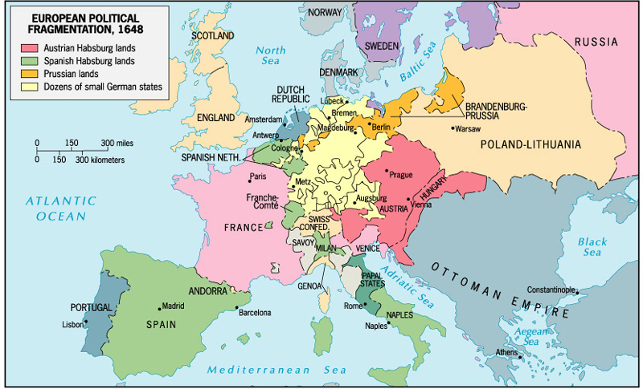
The states we perceive as “natural” and “always existing” are relatively recent phenomena.
In 1648, Europe was divided into dozens of small territories.

Slide 9
20th century boundary changes in Europe, 1914-2003
Notes:
9
In Europe France is the best example of a nation-state
Others-Germany before World War I, Hungary, Denmark, Poland, Czech Republic, Slovenia and Sweden.
NOT nation-states-Bosnia, Moldova, Slovakia, Belgium and Latvia
Revolution and Evolution took place in Europe-absolute rule died out and was replaced by democracy
Some states abolished monarchy-France and Italy
Others retained monarchies as figure-heads; Britain, Netherlands, Belgium, etc.

Slide 11
Multinational State vs. Nation-State
Multinational state
Includes more than one nation within its borders
Examples:
Soviet Union, United Kingdom
Nation-State
A state whose territory corresponds to that occupied by a particular ethnic group
Epitome of the link between political and cultural patterns
Examples:
Finland, Germany, Greece, Armenia, Japan, South Korea

Slide 13
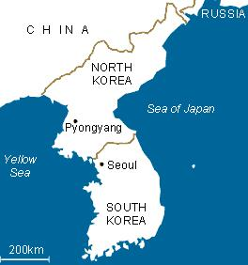
…vs. Multistate Nation
When a nation stretches across borders and across states

Slide 14
The most accurate designation for the United States is:
Nation
Nation-State
Multistate nation
Multinational state
Multi-ethnic state

Slide 15
The most accurate designation for the United States is:
Nation
Nation-State
Multistate nation
Multinational state
Multi-ethnic state

Slide 16
The first widespread use of the nation-state concept came in
A) Mesopotamia
B) the Roman Empire
C) Western Europe
D) the United States
E) Southeast Asia

Slide 17
The first widespread use of the nation-state concept came in
A) Mesopotamia
B) the Roman Empire
C) Western Europe
Began with the Peace of Westphalia (1648)
Diffused throughout Europe as monarchies strengthened
D) the United States
E) Southeast Asia

Slide 18
Colonialism and Geography
Do Now:
What is one effect of the colonial era on the contemporary political map?

Slide 19
(European) Colonialism – 1500-1950
How the nation-state model diffused beyond Europe
One country establishes a settlement in a territory and then imposes its political, economic, and cultural principles on it
Led to uneven global distribution of power
Created a world-economy

Slide 20
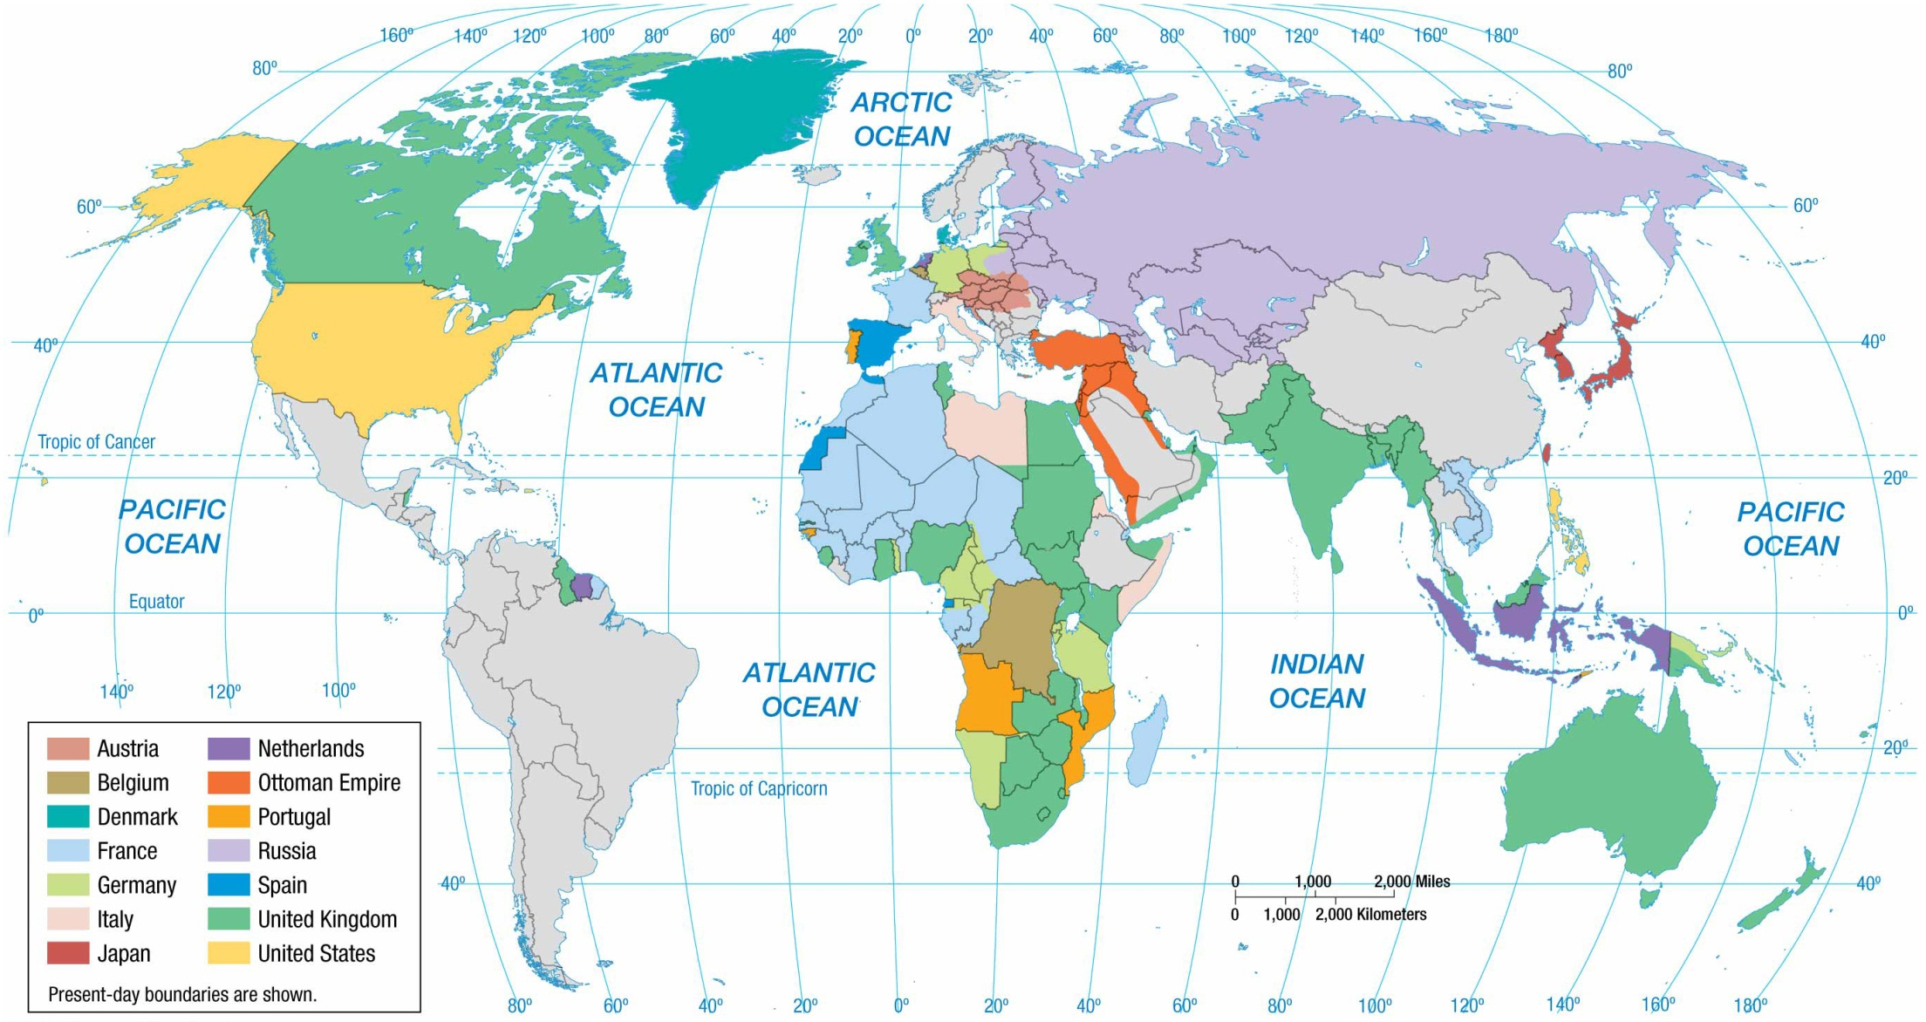
COLONIAL POSSESSIONS, 1914 At the outbreak of World War I in 1914, European states held colonies in much of the world, especially in Africa and Asia. Most of the countries in the Western Hemisphere were at one time colonized by Europeans but gained their independence in the eighteenth or nineteenth centuries.
Notes:
FIGURE 8-23 COLONIAL POSSESSIONS, 1914 At the outbreak of World War I in 1914, European states held colonies in much of the world, especially in Africa and Asia. Most of the countries in the Western Hemisphere were at one time colonized by Europeans but gained their independence in the eighteenth or nineteenth centuries.

Slide 21
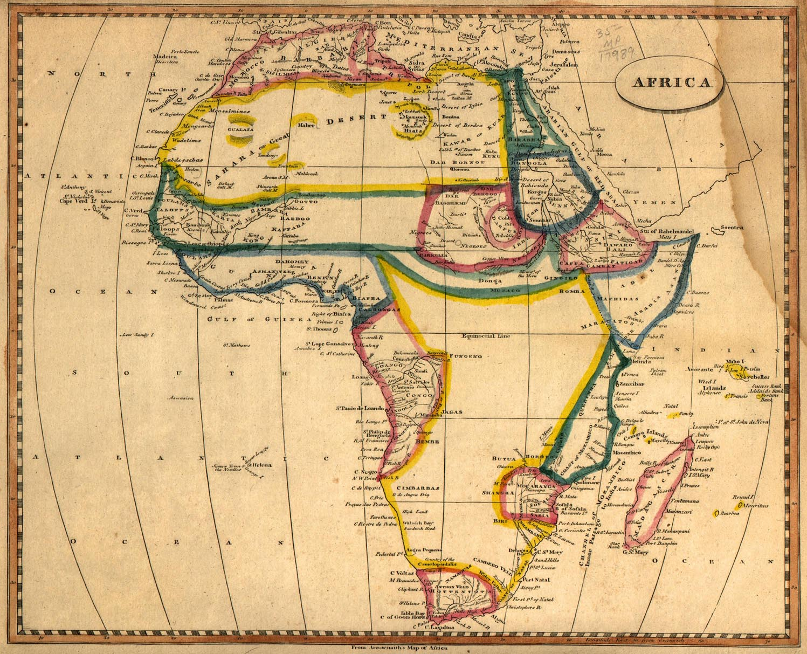
Africa in 1812

Slide 22
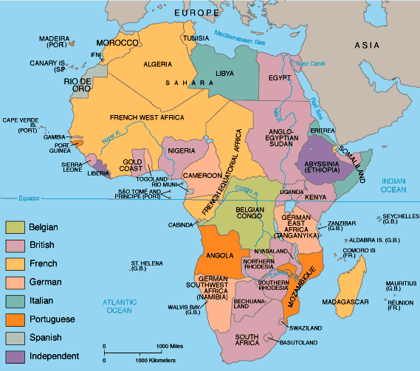
Partition of Africa

Slide 23
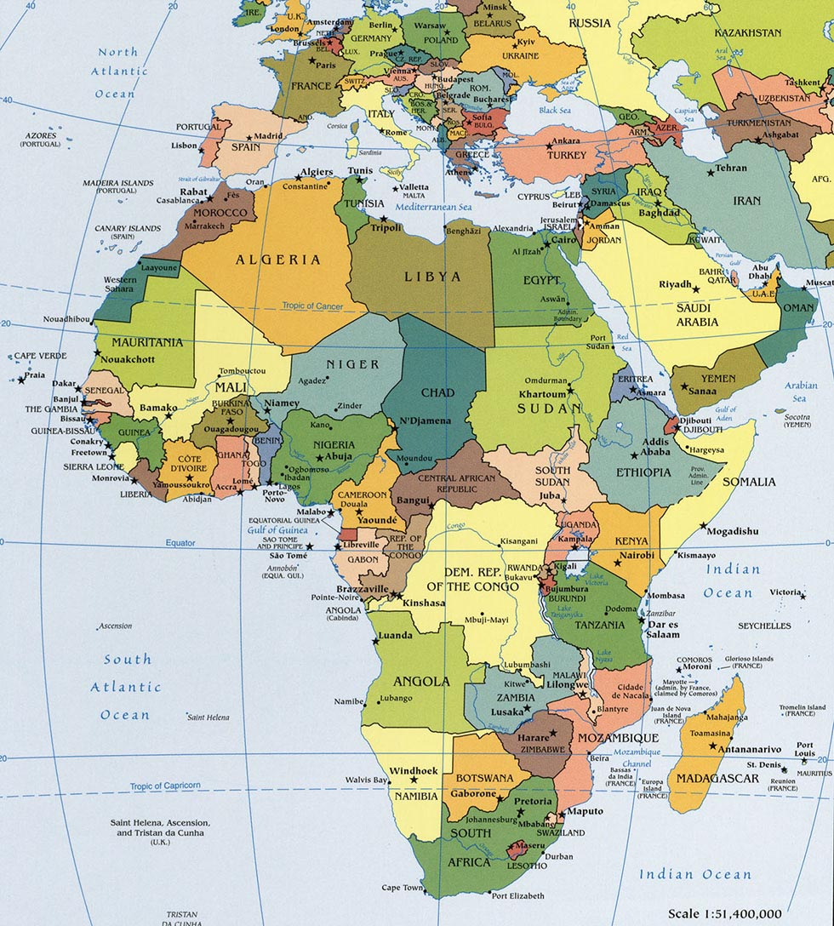

Slide 24
2014 FRQ #2
The international borders of African countries are a legacy of colonialism.
Describe the concept of a superimposed boundary.
A boundary line or border placed over and ignoring an existing cultural pattern OR arbitrarily imposed by external powers.
Describe three political or cultural consequences of superimposed boundaries in Africa.
Consequences = results/effects; not necessarily negative
Identify and explain one challenge landlocked African countries face in developing viable economies.

Slide 25
B. Consequences of superimposed boundaries in Africa
Multinational or multiethnic state – separate nations within the same country
Multistate nation – culture group split into pieces, made into minority groups
Internal struggle – increased likelihood of international, regional, or cross-border conflict
Loss of culture – loss of language, traditions, etc.
Cultural syncretism – between culture groups of a single country
Migration – may increase number of refugees or IDPs; traditional or seasonal migration patterns disrupted
Government change – nation-building difficulties, non-viable states, formation of new independent states, relocated capitals
Lost or limited access to natural resources – economic dependency

Slide 26
C. Challenges for landlocked African countries in developing viable economies
Access to the sea – lack of easy access to maritime trade or ocean resources
Increased cost of imports – due to customs, tariffs, tolls, distance, or transportation costs
Limited road or rail transportation for imported goods in bulk – more break-of-bulk points
Will define in Industry unit!
Economic cooperation – communications needed between landlocked and bordering states
Vulnerability – can be cut off from global trade and/or political support by hostile neighbors; economically dependent

Slide 27
Wallerstein: Immanuel vs. Melissa

Slide 28
World-Systems Theory (p. 220)
Immanuel Wallerstein
To understand any state, you need to understand its relationships within the world-economy
The world-economy has one market and a global division of labor
Although the world has many states, almost everything takes place within the context of the world economy
The world-economy has a three-tier structure
Core
Periphery
Semiperiphery

Slide 29
Who’s theory is this?

Slide 30
The Three-Tiered Structure of the World-Economy
Core (Many were colonial powers)
More commonly has core processes that generate more wealth in the world-economy
Higher levels of education
Higher salaries
More technology
Periphery (Many were colonies)
More commonly has peripheral processes associated with a more marginal position in the world economy
Lower levels of education
Lower salaries
Less sophisticated technology
Semiperiphery
Places where core and periphery processes are both occurring
Places that are exploited by the core but exploit the periphery

Slide 31
In closing…
Explain the connection between:
Colonialism
World-system theory
Fragile states

