Slide 1
DEAC Meeting Agenda: 9.18.14
1. AchieveNJ
Update 8.12.14
ScIP Update 8.14 (+ Sharing with DEAC next meeting)
Resources: Teacher Evaluation Scoring Guide 2014-15, 14-15 TeacherEvalChart, Resources Catalog, and Approved List of Evaluation Models
2. Marzano Update
3. Verona Student Growth Objectives (VGO)
4. Professional Learning

Slide 2
AchieveNJ Update
2013-14 Student Growth Objective Score Review Process and Administrator Goal Score Review Process
If a teacher’s Student Growth Objective (SGO) score or a principal/assistant principal(AP)/vice principal(VP)’s Administrator Goal score is the sole reason that his or her summative rating dropped from Effective to Partially Effective or from Partially Effective to Ineffective, the educator will be eligible to ask for an expedited review of the rating.
In addition, if a teacher’s rating is adjusted through the SGO review, that teacher’s SGO score may be negated from the principal’s SGO average if doing so improves the principal’s rating from Ineffective or Partially Effective to Effective or Highly Effective.

Slide 3
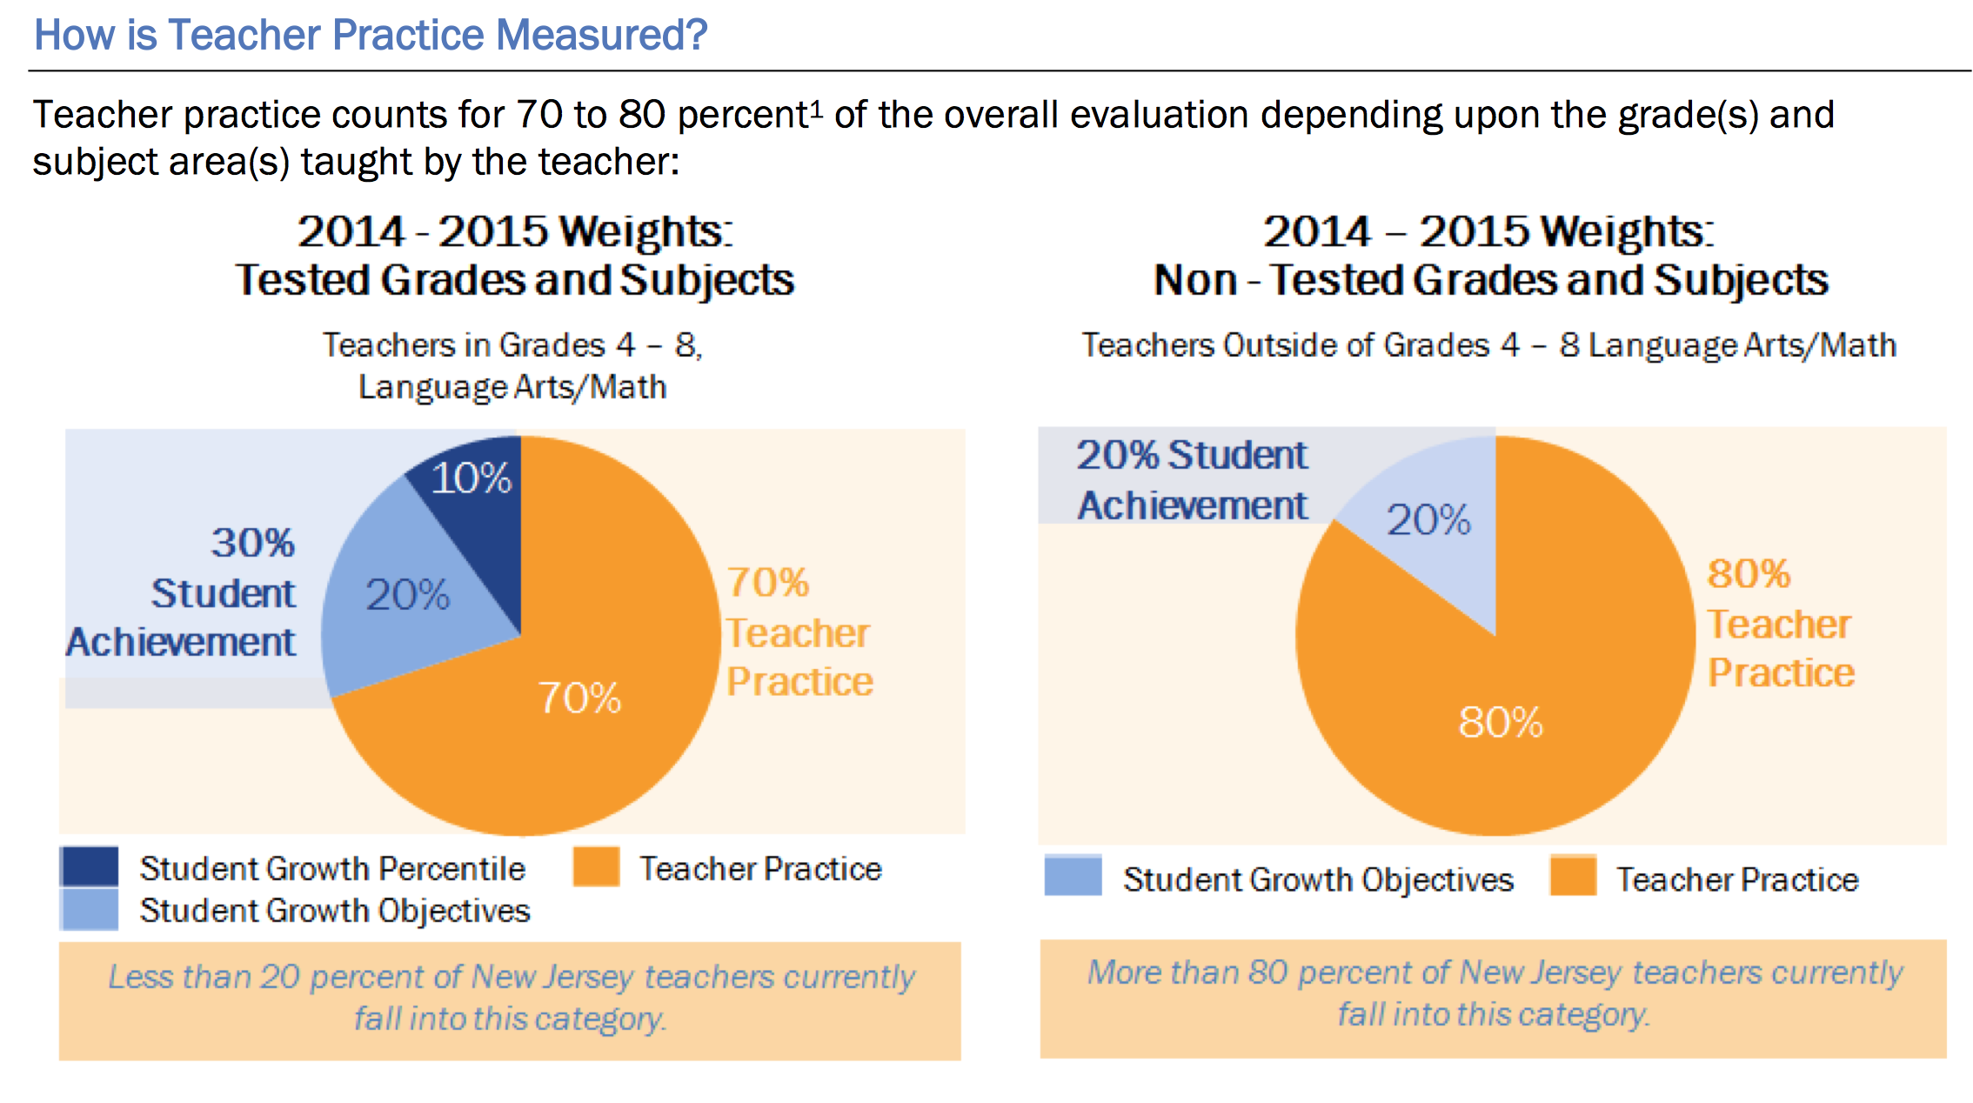
AchieveNJ Update
2014-15 Teacher Evaluation

Slide 4
ScIP Update
The School Improvement Panel: Strengthening Evaluation at the Building Level
The ScIP must include the school principal, an assistant/vice principal or a designee if the school does not have one, and a teacher.
As of 2015-16, teachers serving on ScIPs must have earned a rating of Effective or Highly Effective in the most recent evaluation. Until then, the teacher must meet local standards for having “a demonstrated record of success in the classroom.”
Teachers on ScIPs will become important “resident experts” on evaluation policies and supports for other teachers. Teacher representatives will help to ensure open communication and opportunities for feedback among colleagues.

Slide 5
ScIP Update
Required and Suggested Activities
The members of the ScIP have the following specific responsibilities under the TEACHNJ Act:
Ensuring that evaluation procedures are implemented;
Ensuring that procedures for Corrective Action Plans are implemented;
Identifying PD opportunities for staff members;
Overseeing the mentorship of new teachers at the building level.
Other Ideas? Please take a moment to discuss…

Slide 6
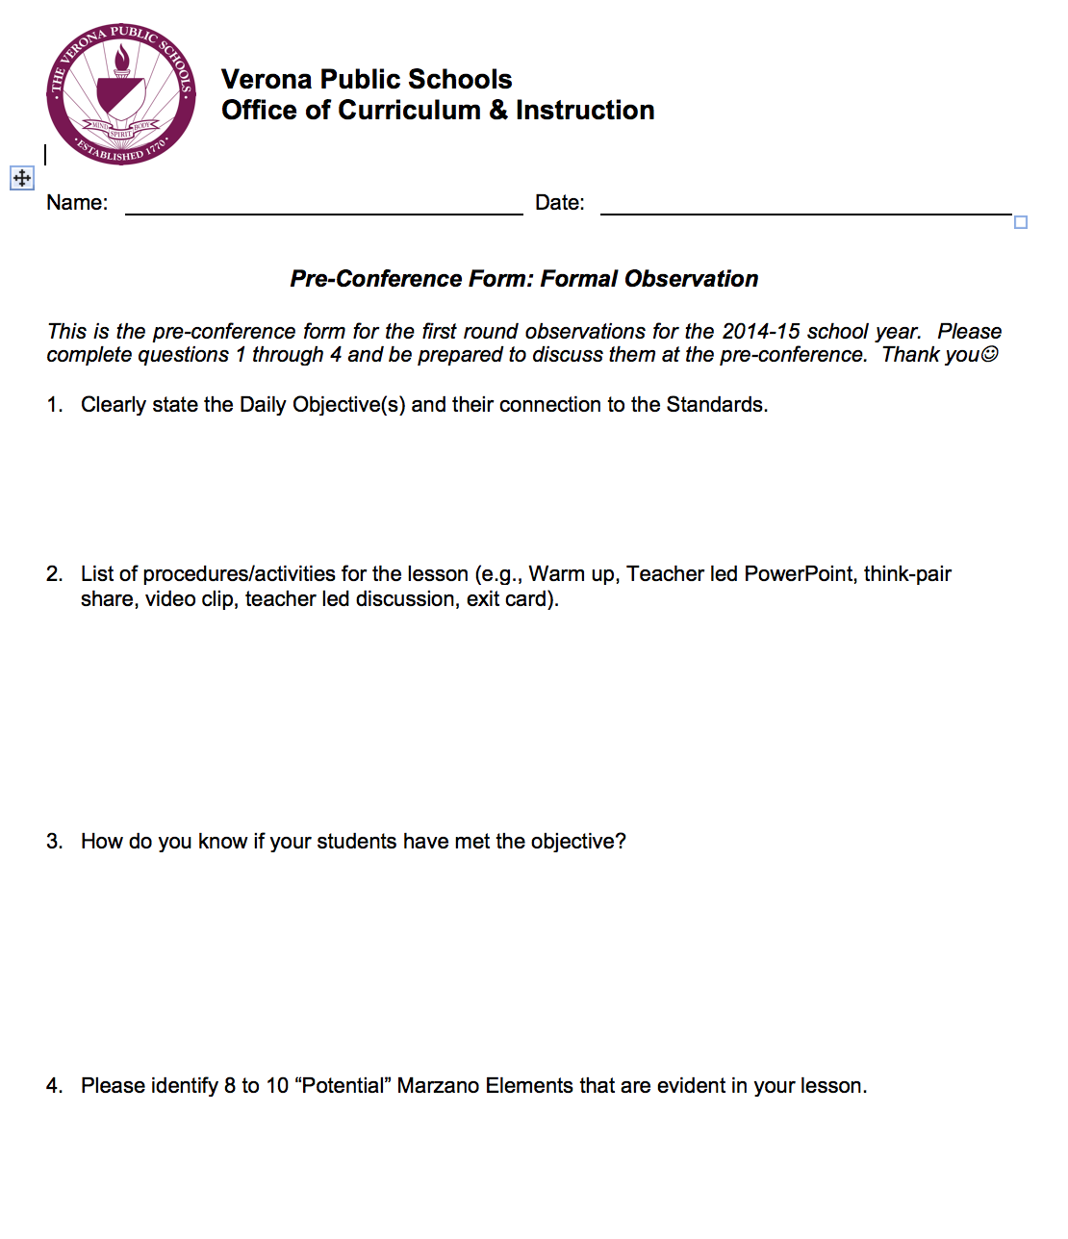
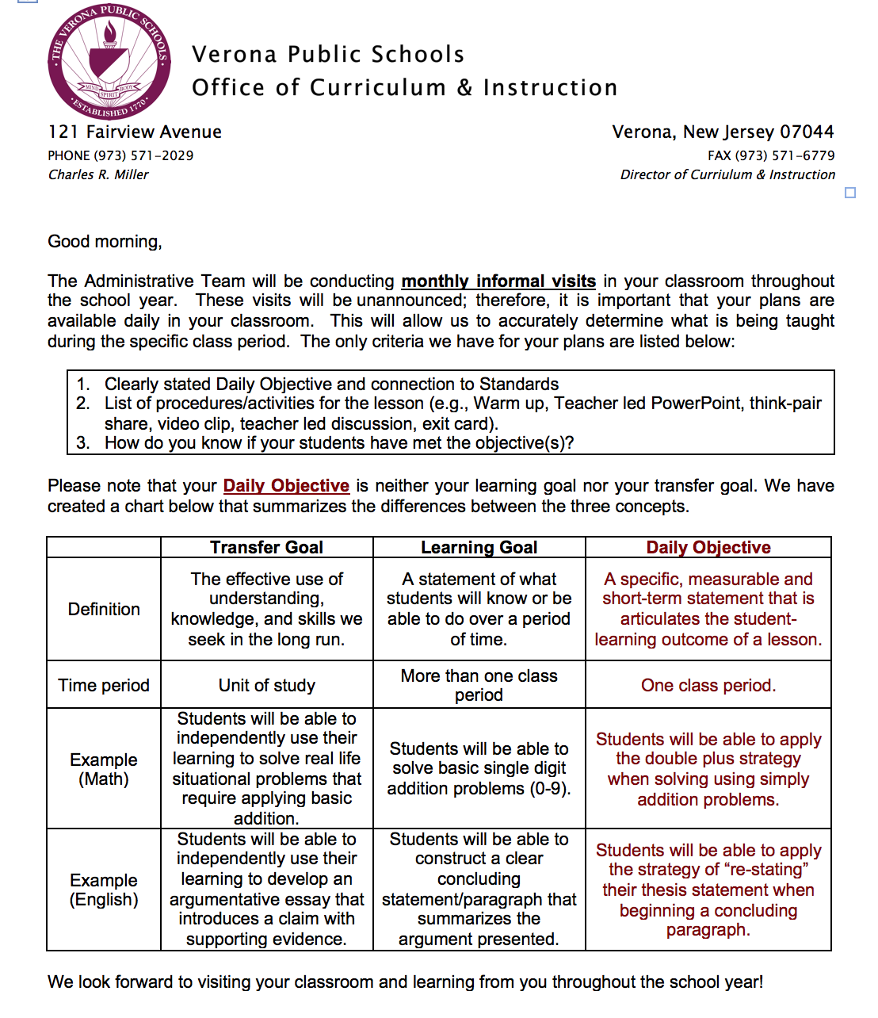
Marzano Update
Lesson Plan Expectations for Formal Observations/Informal Visits
Clearly stated Daily Objective and connection to Standards
List of procedures/activities for the lesson (e.g., Warm up, teacher led PowerPoint, think-pair share, video clip, teacher led discussion, exit card).
How do you know if your students have met the objective(s)?

Slide 7
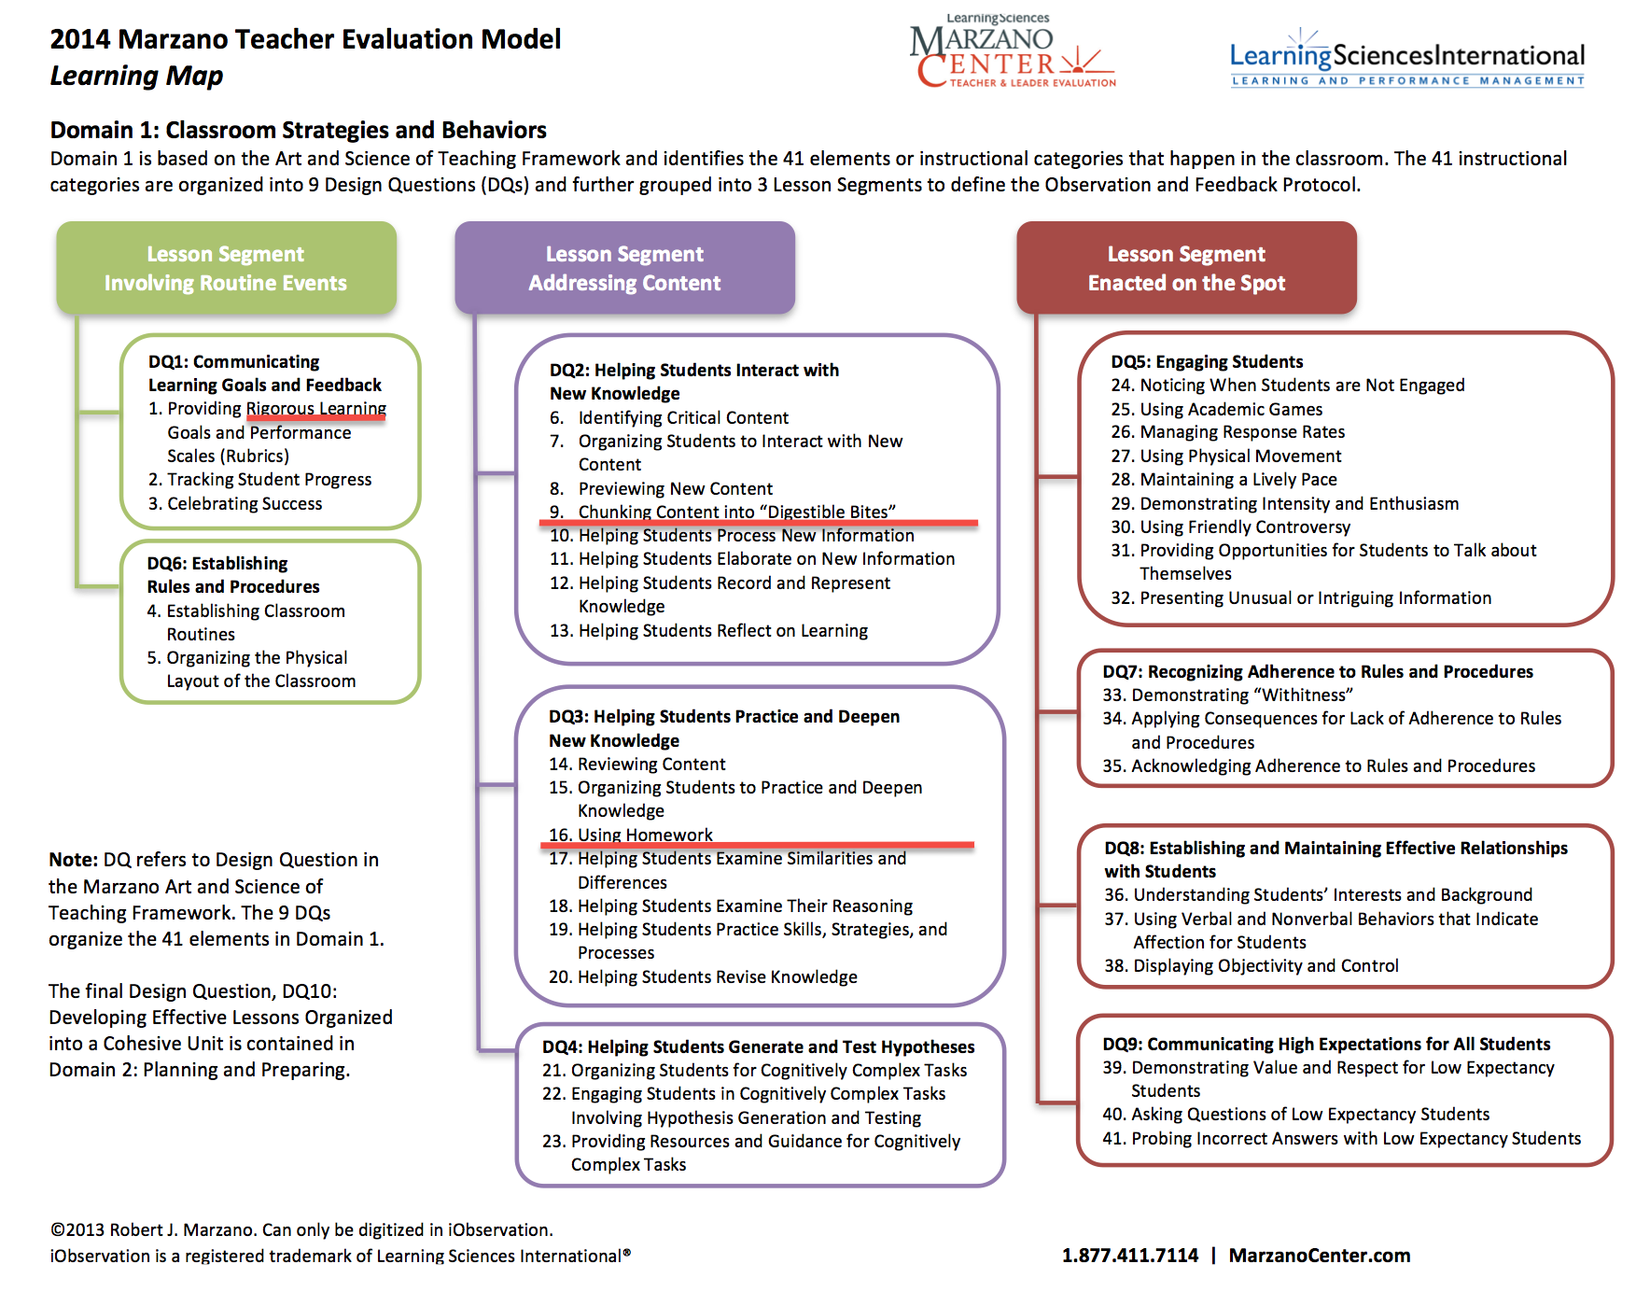
Marzano Update
Domain 1: All 41 Elements Are Now Active ☺

Slide 8
Formal Observations
Non-Tenured
Tenured

Slide 9
Final Evaluation 2014-15
Marzano (70% for SGP, 80% for Non-SGP)
Domain 1 = 70%
Domains 2-4 = 10% Each
Reflect monthly to avoid “March Madness”
VGO
20% for ALL Teachers
SGP
10% for ALL ELA/Math Teachers Grades 4-8

Slide 10
Verona Student Growth Objectives
Emphasize GROWTH
As part of ROUTINE PRACTICE
Avoid BIG Pre/Post Tests
Consider Unit Based Growth Objectives

Slide 11
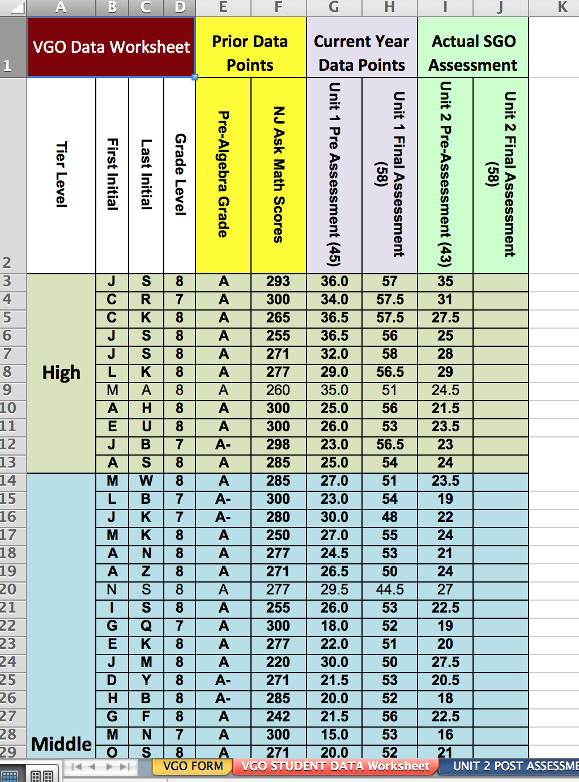
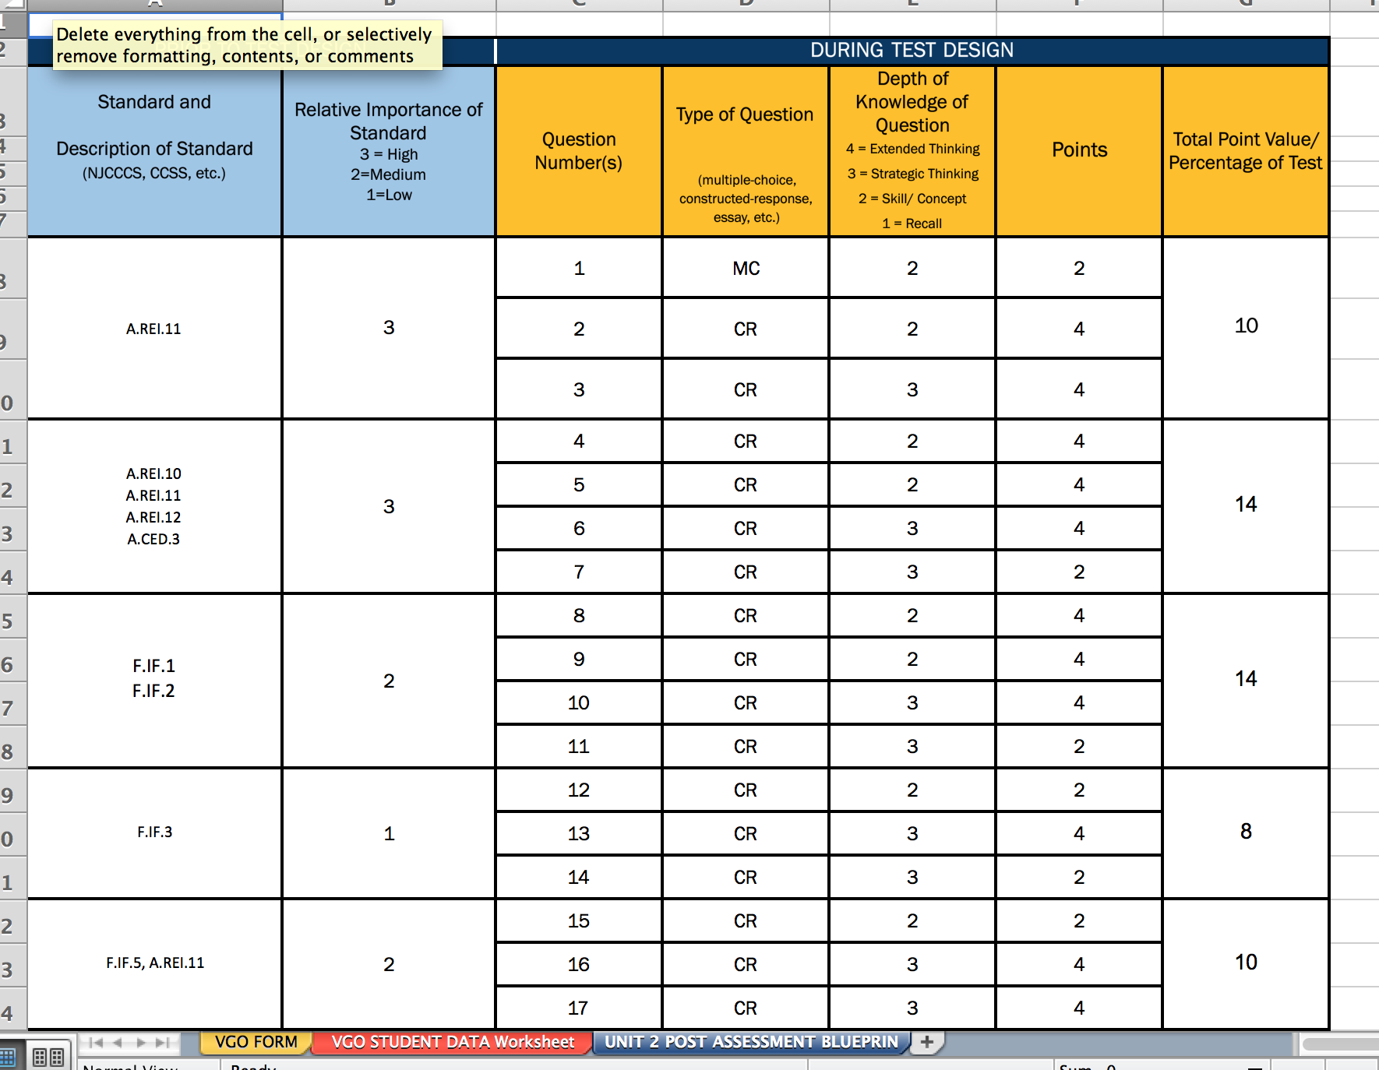
Verona Student Growth Objectives
Streamlined Excel Form (veronaschools.org/ Page/2673)
Data form included
Designed & vetted using Assessment Blueprint Spreadsheet
Teacher Driven
VGO

Slide 12
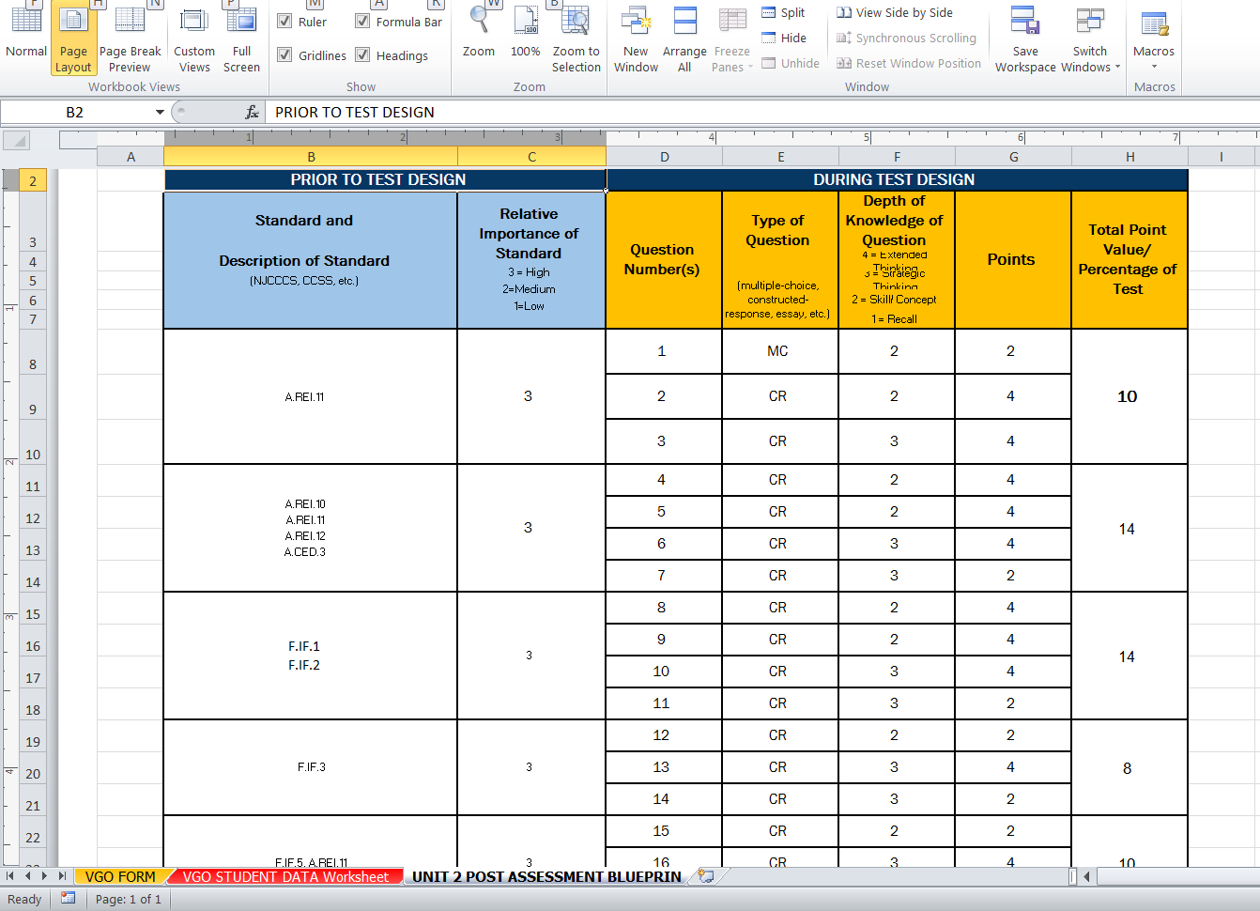
District Goal: Enriching our Stage 2 Assessments & Performance Based Tasks
Submit Unit Assessments Prior to Instruction of the Unit (as the year progresses…)
Assessment should designed and vetted using the Assessment Blueprint Spreadsheet

Slide 13
District Goal: Enriching our Stage 2 Assessments & Performance Based Tasks
We are working toward…
Enriching question complexity to approach PARCC
1/3 DOK 1 : 1/3 DOK 2 : 1/3 DOK 3 to mimic EOY
Transfer Tasks should approach DOK 4 to mimic PBA

Slide 14
Professional Learning
September 24th
HAZCom Training for Science & Art Teachers & Custodians
Work on Unit Assessments & Performance Based Tasks (DOK) & VGOs by Departments
October 31st
Wrap up VGOs
Continue work on Unit Assessments & Performance Based Tasks (DOK)
Dyslexia Training (Elementary teachers)
Complete Online Professional Development (Blood Bourne…)
November 4th
All Staff will meet at the VHS Auditorium for HIB, Affirmative Action, School Security Updates, Review PARCC (PBA/EOY)

