Slide 1
Assessments aligned to Common Core State Standards

Slide 2
The IDEA Partnership extends appreciation to, and acknowledges the contributions of, 29 cross-stakeholders representing
Teachers,
General Education Administrators,
Special Education Administrators,
Specialized Instructional Support Providers,
Families,
Higher Education,
Technical Assistance Providers, and
Policymakers
from 15 states across the country, in the creation of this presentation.

Slide 3
Agenda
Common Core State Standards
Assessment development
General assessments
Alternate assessments
English Language Learner assessments
Resources for more information

Slide 4
Common Core State Standards Initiative
National Governors Association Center for Best Practices (NGA Center)
Council of Chief State School Officers (CCSSO)

Slide 5
To address…
Disparate standards across states
Student mobility
Skills needed for today’s jobs/careers
Global competition
Fundamentally different from most state learning standards of the past

Slide 6
Assessments
Curriculum Design
Lesson Planning
Instruction
Student Learning
Assessments
Common Core State Standards

Slide 7
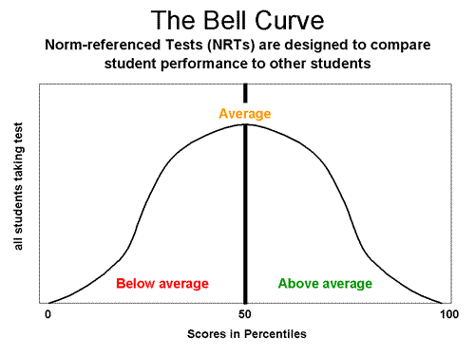
New assessments…
Aligned to Common Core State Standards
Focused on student outcomes
Knowledge
Skills
Processes (writing, thinking, problem-solving)

Slide 8
Work in progress…
General Assessments
Partnership for Assessment of Readiness for College and Careers (PARCC)
Smarter Balanced Assessment Consortium (SBAC)
Alternate Assessments
Dynamic Learning Maps Alternate Assessment System Consortium (DLMAASC)
National Center and State Collaborative Partnership (NCSC)
ELL Assessments
Assessment Services Supporting ELs through Technology Systems (ASSETS)
English Language Proficiency Assessment for the 21st Century Consortium (ELPA21)

Slide 9
General Assessments…
2014-15 implementation
Most all students
Built in accommodations
Formative and summative
Variety of types of questions
Use of technology
Professional development resources

Slide 10
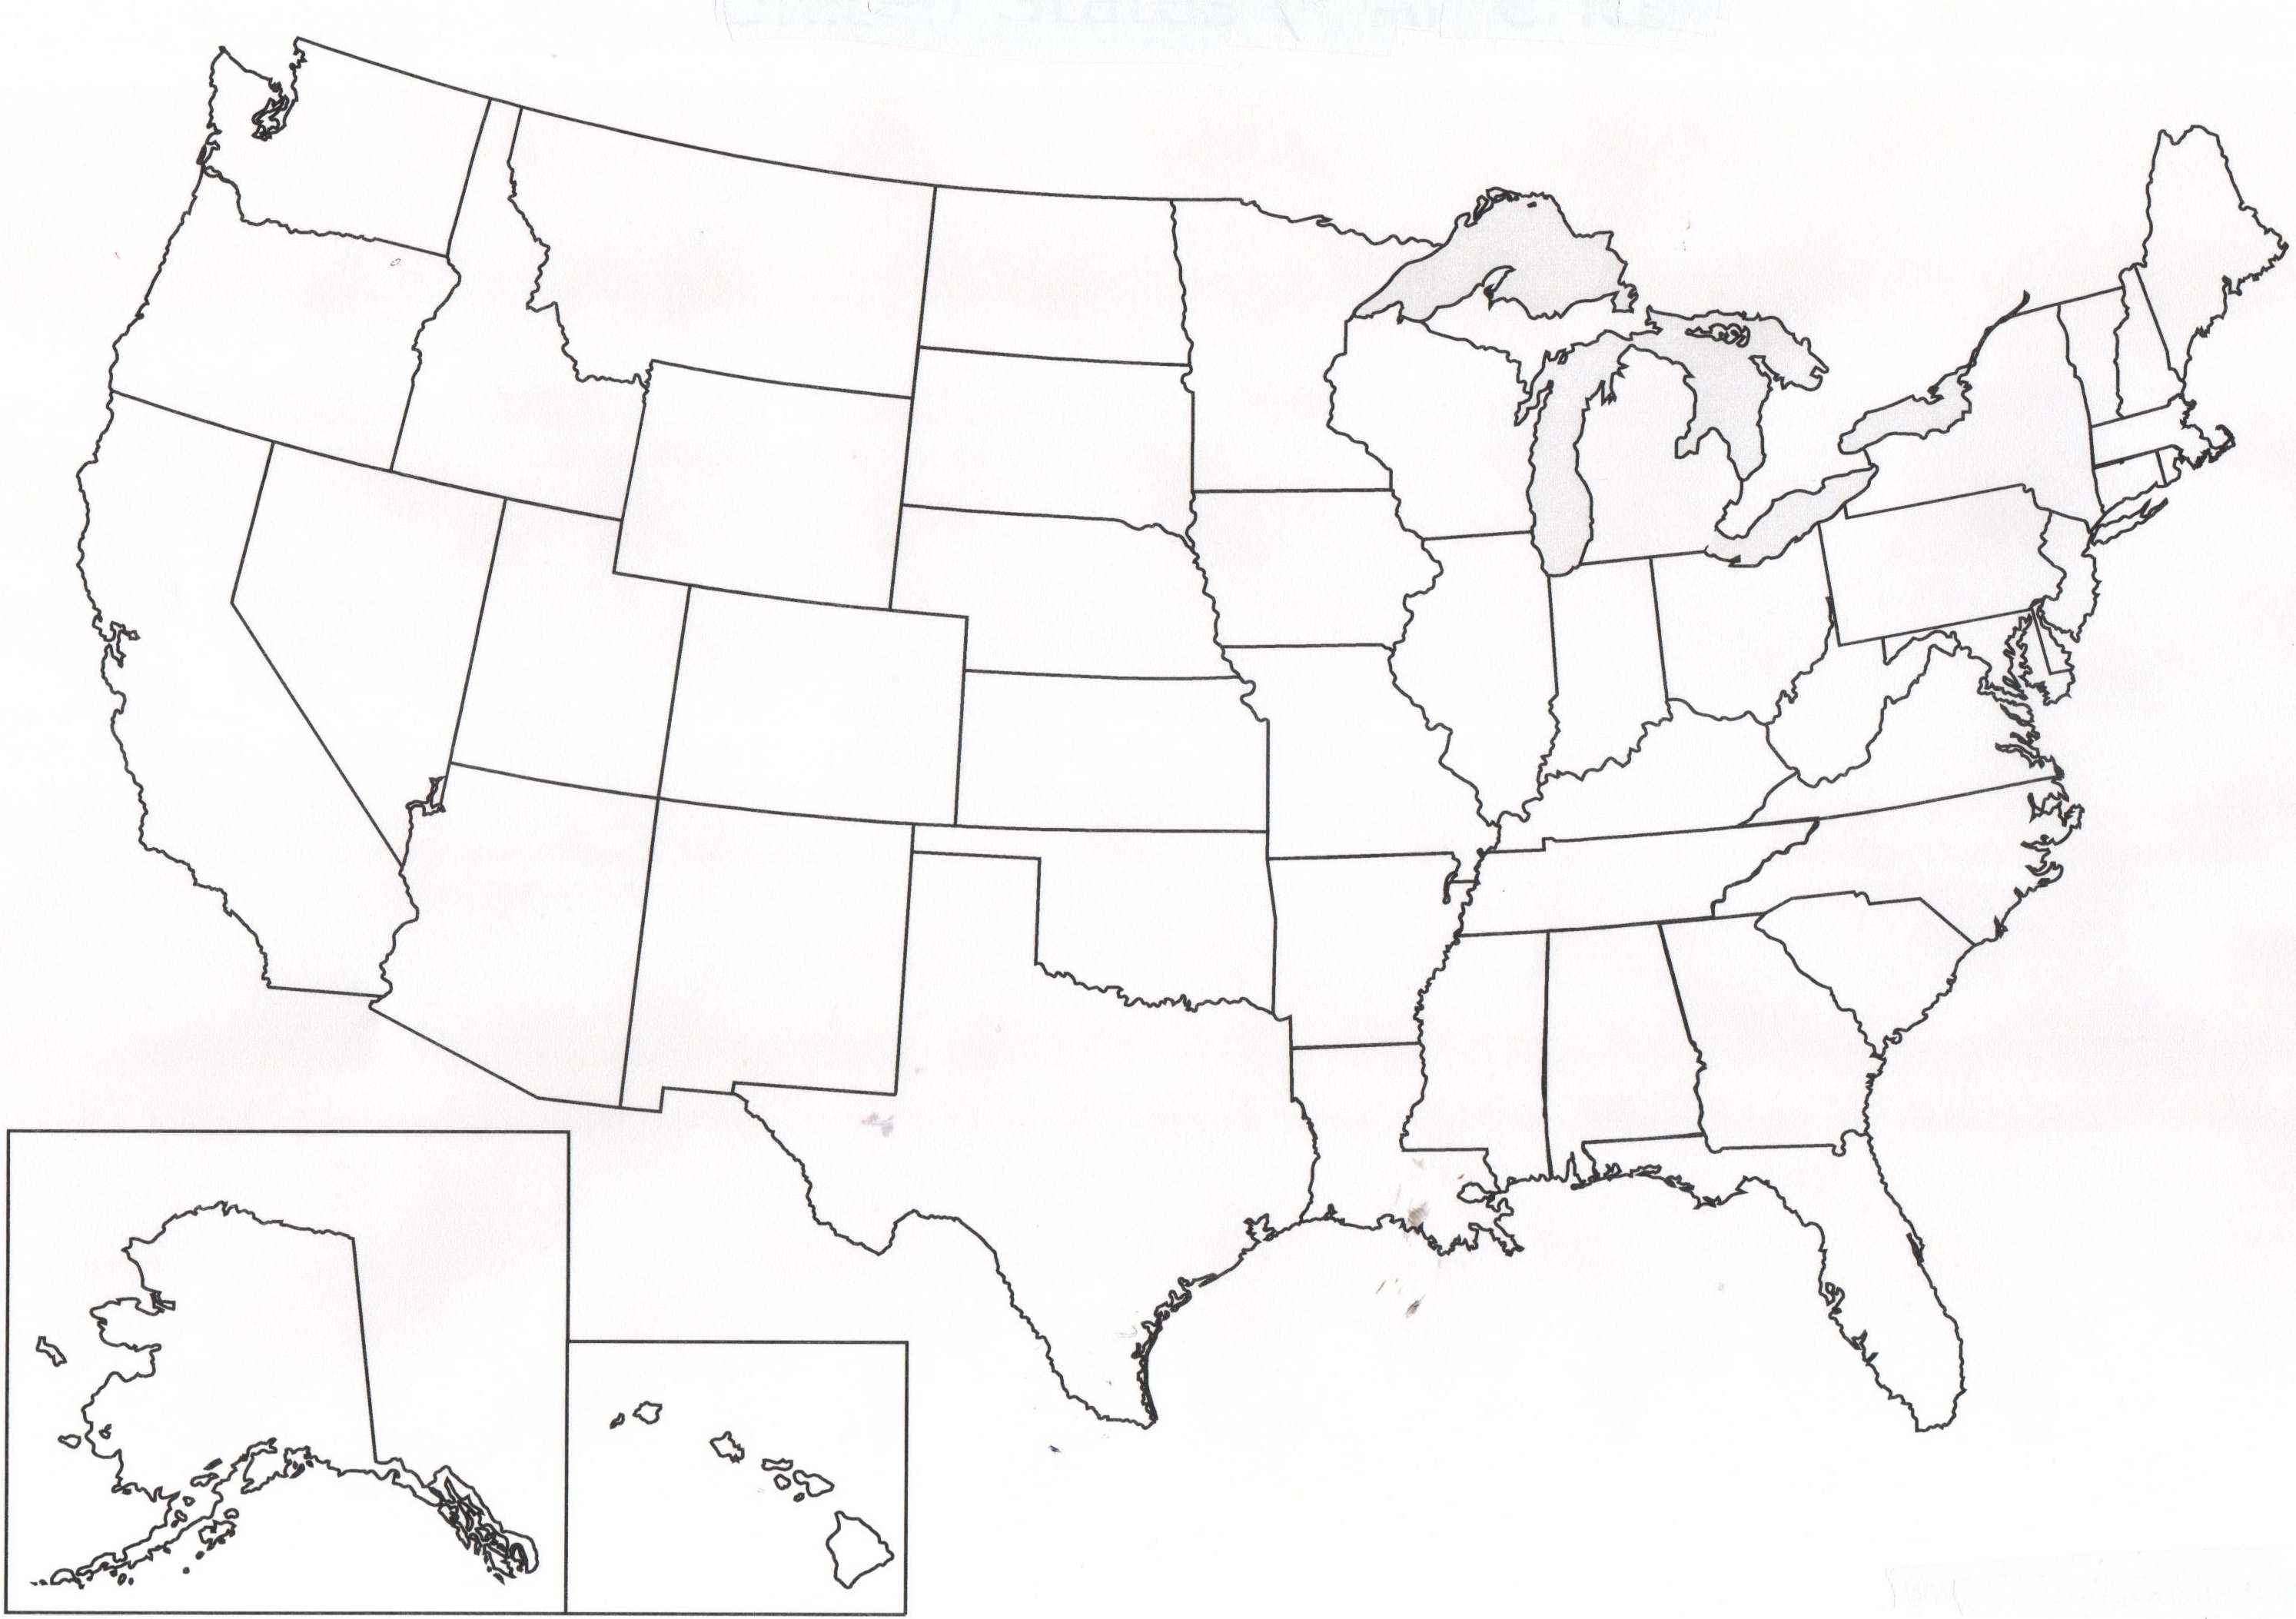
PARCC States x Partnership for Assessment of Readiness for College and Careers
NY
MA
PA
RI
IN
OH
NJ
CO
IL
MD
KY
DC
AZ
TN
NM
AR
MS
LA
FL

Slide 11
PARCC Design
Summative assessments
Grades 3-8: end of year
Grades 9-11: end of course
Optional formative mid-year project
Online technology
Accessibility for all
Notes:
For expanded version

Slide 12
Source: Coming together to raise achievement. June 2013. ETS

Slide 13
PARCC Timeline
SY 2010-11
Launch and design phase
SY 2011-12
Development begins
SY 2012-13
First year pilot/field testing and related research and data collection
SY 2013-14
Second year pilot/field testing and related research and data collection
SY 2014-15
Full administration of PARCC assessments
Summer 2015
Set achievement levels, including college-ready performance levels

Slide 14
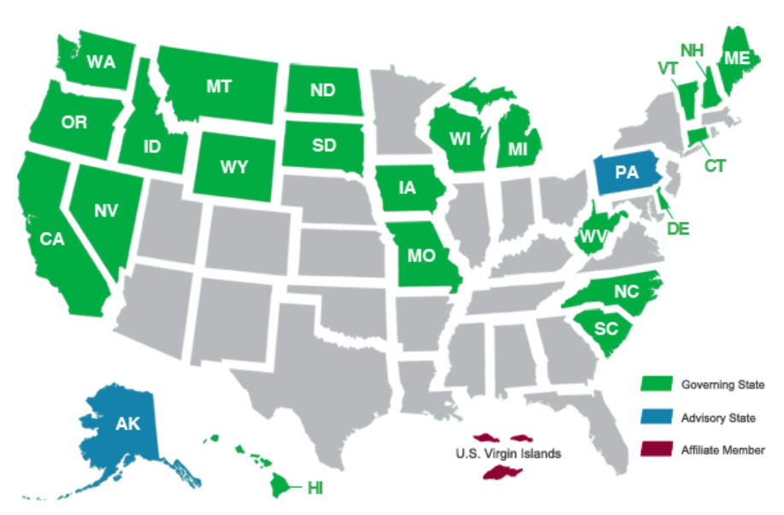
SBAC States vvvjhhhhhhh Smarter Balanced Assessment Consortium

Slide 15
SBAC Design
Summative assessments
Grades 3-8 and high school
In last 12 weeks of school year
Optional formative assessments
Computer adaptive testing
Notes:
For expanded version

Slide 16
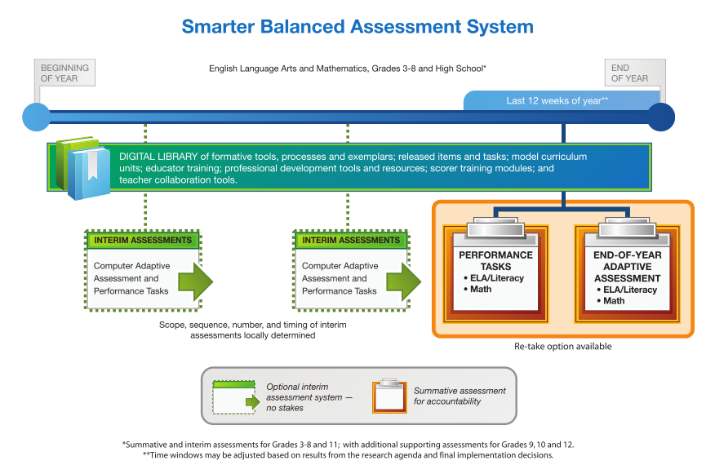
Source: Coming together to raise achievement. June2013. ETS

Slide 17
SBAC Timeline
2010
Tools, processes and practices development begins
2011
Item specifications developed
2012
Item development activities completed; item pool available for administration
2013
Field testing of adaptive summative items
2014
Preliminary summative achievement standards proposed
2015
Operational summative assessment; verification of achievement standards

Slide 18
Key similarities…
Summative assessments
Online
Grades 3-8 and high school in ELA and Math
Mix of item types
Two components; administered end of year
Performance-based assessments
End-of-year comprehensive assessments
Electronic and human scoring; two-week return

Slide 19
Key similarities… (continued)
Other features
Practice tests
Optional interim assessments
Professional development modules
Formative items/tasks for classroom use
Online reporting suite
Digital library

Slide 20
Key differences…
PARCC
SBAC
Fixed-form summative assessment
PBA
3 tasks for ELA
1 task or more in math
Retake opportunity
Gr. 3-8: once
HS: up to three times
Paper & pencil – available for 1 year and as an accommodation
Required non-summative speaking and listening assessment
Computer adaptive summative assessment
PBA
1 task for ELA
1 task for math
Retake opportunityfor test administration irregularity
Paper & pencil – available for 3 years and as an accommodation

Slide 21
Alternate Assessments…
2014-15 implementation
1% of student population
Alternate achievement standards
Universal Design for Learning embedded
Technology use
Professional development resources

Slide 22
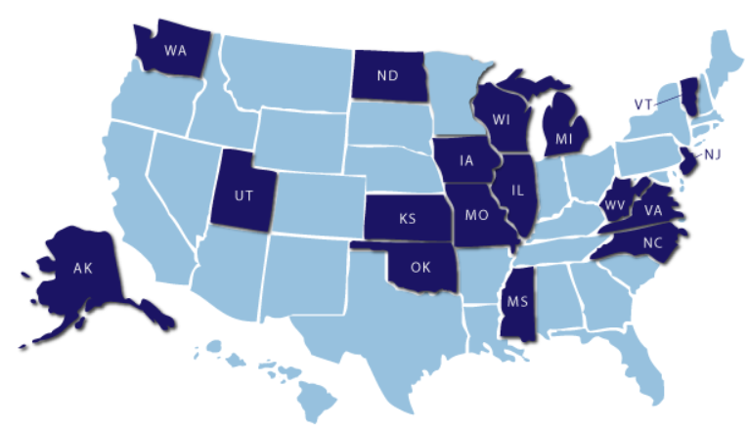
DLM States x xx x xxxxxxxxxx Dynamic Learning Maps Alternate Assessment System Consortium

Slide 23
DLM Design
Common Core Essential Elements (CCEE)
Learning maps
Dynamic assessment
Universal Design for Learning concepts
Professional development
Notes:
For expanded version

Slide 24
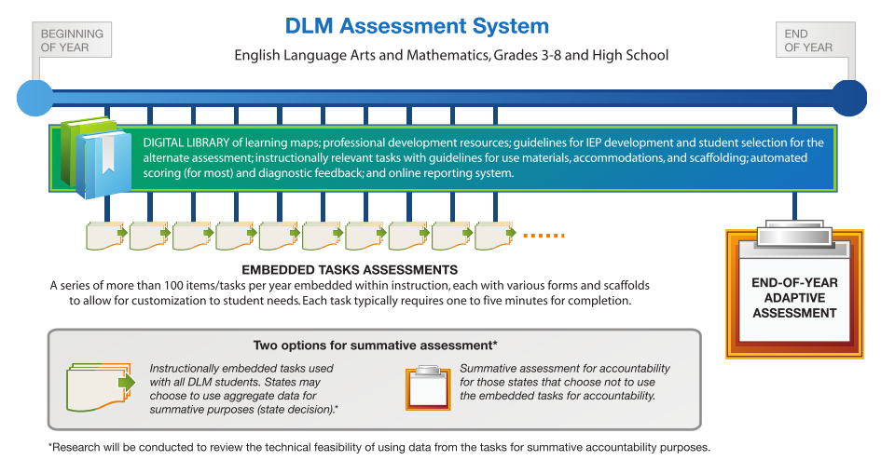
Source: Coming together to raise achievement. June 2013. ETS

Slide 25
DLM Timeline
2010-11
Work begins
Jan-Mar ‘12
CCEE and Achievement Level Descriptors developed
June-Sept ‘12
Pilot testing; Learning Maps developed
Jy-Aug ‘14
Software ready; instructionally Embedded Testing available
Spring ‘15
Stand-alone Summative Test available
Fall ‘15
Professional development program validated; evaluation of system

Slide 26
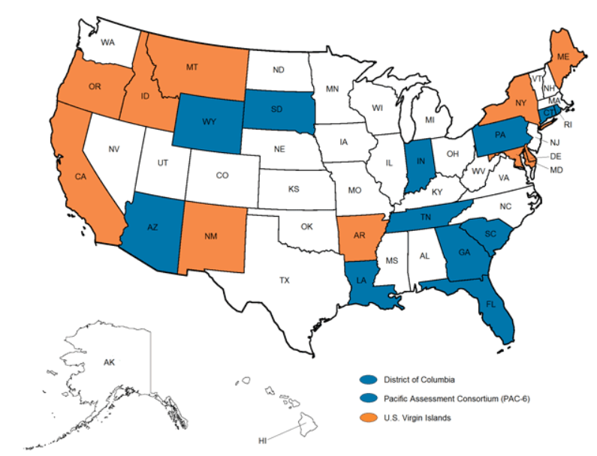
NCSC States xxxxxxxxxxx National Center and State Collaborative Partnership

Slide 27
NCSC Design
Alternate assessment based on alternate achievement standards
Based on grade-level content
Different achievement expectations
For students with significant cognitive disabilities
Appropriately challenging
Curriculum, instruction, and professional development resources
Notes:
For expanded version

Slide 28
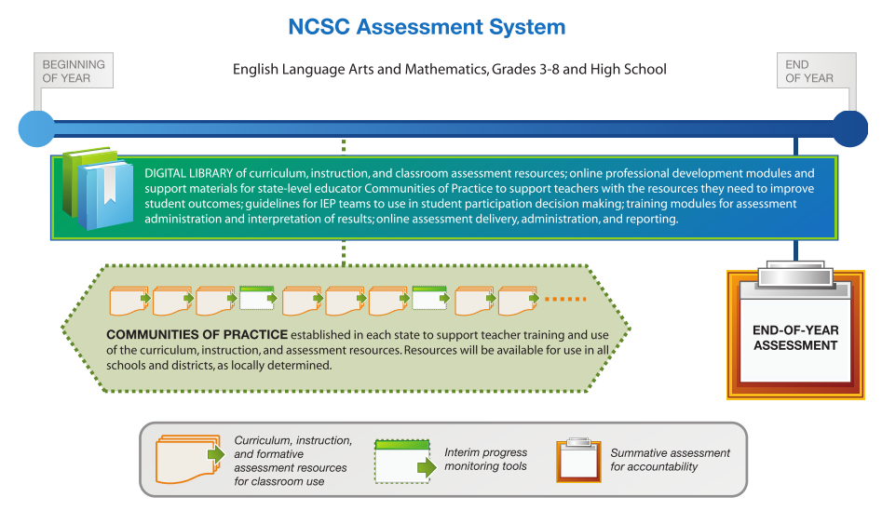
Source: Coming together to raise achievement. June 2013. ETS

Slide 29
NCSC Timeline
Oct ‘11 – Je ‘12
Launch and design phase; including CoP
Jy – Dec ‘12
Tool development and sample field testing
Ja – Je ‘13
Revisions based on field test; integrate CIA training in states; accommodation manual
SY 2013-14
Finalize test blueprint, items, and reporting system
Ja-Se ‘14
Field test all alt assess students; set cut scores; validation studies
SY 2014-15
Fully operational

Slide 30
Key similarities…
Online assessment system
Student response when possible
Teacher management of data
Attend to communication, sensory, and motor needs
Professional development resources

Slide 31
Key differences…
DLM
NCSC
Common Core Essential Elements
Embedded tasks
Series of 100 or more items/tasks throughout year
5-10 minutes per task
Optional stand-alone summative assessment
Grade-level assessment content targets
Trained teachers in each state to support implementation

Slide 32
English Language Proficiency Assessments …
Equitable opportunities for English language learners
Assess English language proficiency
Use of technology

Slide 33
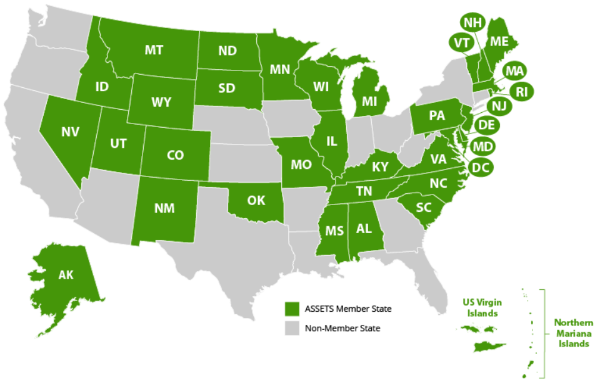
ASSETS States xxxxxxxxxxx Assessment Services Supporting ELs through Technology Systems
Notes:
For expanded version

Slide 34
ASSETS Design
Measure English language proficiency linked to Common Core State Standards
K-12 assessments
Technology based
Screeners for identification and placement
Interim and annual assessments
Notes:
For expanded version

Slide 35
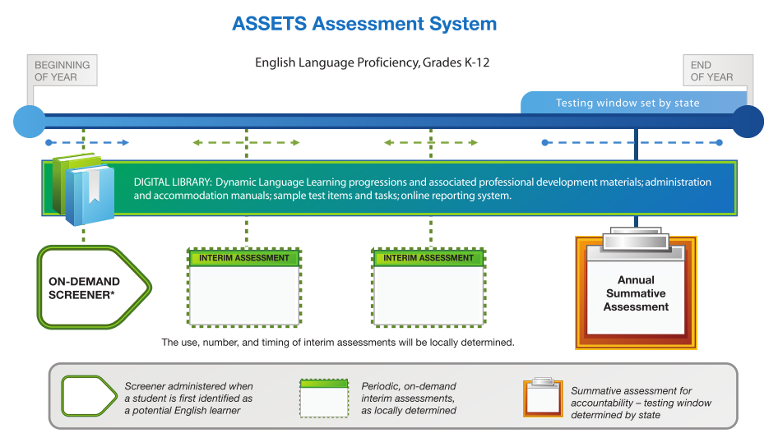
Source: Coming together to raise achievement. June 2013. ETS

Slide 36
ASSETS Timeline
SY 2011-12
Initial test design
SY 2012-13
Create item specification; begin pilot testing; initiate professional development materials
SY 2013-14
Field test; complete accommodations materials; professional development materials
SY 2014-15
Reliability and validity studies; reporting system and training materials
SY 2015-16
Operational assessment system
SY 2016-17
System evaluation

Slide 37
ELPA21 States xxxxxxxxxxx English Language Proficiency Assessment for the 21st Century Consortium (ELPA21)
WA
OR
NE
IA
OH
KS
WV
AR
SC
LA
FL
Notes:
For expanded version

Slide 38
ELPA21 Design
Measure English language proficiency linked to Common Core State Standards
K-12 assessments; in grade bands
Technology based
Screeners for identification and placement
Interim and annual assessments
Notes:
For expanded version

Slide 39
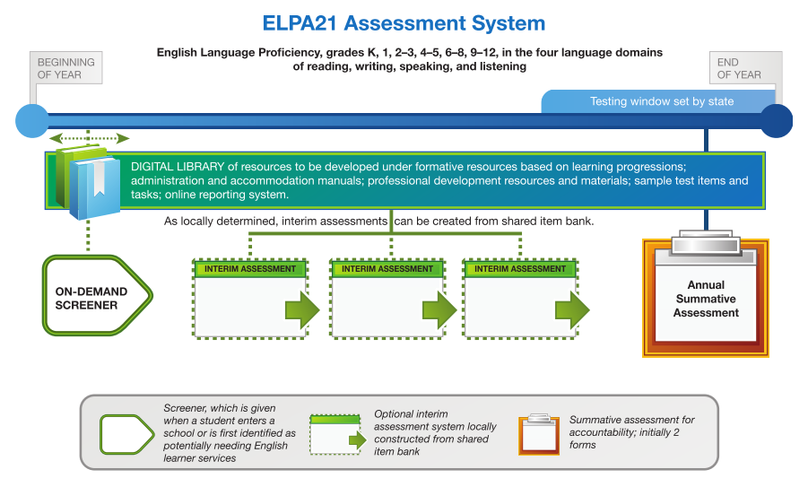
Source: Coming together to raise achievement. June 2013. ETS

Slide 40
Key similarities…
Four language domains
Listening
Speaking
Reading
Writing
Diagnostic screeners
Formative and summative assessments
Professional development

Slide 41
Key differences…
ASSETS
ELPA21
Each grade level
Operational 2015-16
Grade-level bands
Operational 2016-17

Slide 42
For accountability…
Each state and territory determines
General assessment
Alternate assessment
ELL assessment
Accountability for ALL

Slide 43
For more in-depth information on the assessments being developed…
Download CCSS Resource Guide on the IDEA Partnership website
http://www.ideapartnership.org/media/documents/CCSS-Collection/ccss_resources4.pdf

Slide 44
For further information…
Common Core State Standards Initiative www.corestandards.org
Partnership for Assessment of Readiness for College and Careers www.parcconline.org
Smarter Balanced Assessment Consortium www.SmarterBalanced.org
Dynamic Learning Maps Alternate Assessment System Consortium www.dynamiclearningmaps.org

Slide 45
For further information… (cont.)
National Center and State Collaborative Partnership (NCSC) www.ncscpartners.org
Assessment Services Supporting ELs through Technology Systems www.assets.wceruw.org/
English Language Proficiency Assessment for the 21st Century Consortium (ELPA21) www.ELPA21.org

Slide 46
Reflections! Questions? Discussion.
?
.
!
.
?
!
!
?

