Slide 1
How Are Local Cultures Sustained?
Do Now: Find evidence of local/folk culture in this room right now.

Slide 2
Custom
A repetitive act of a group performed to the extent that it becomes characteristic of the group
In South Korea, business cards are presented and accepted with two hands
Italian men kiss each other on (both) cheeks
What are the customs of VHS?
Reading: Sacred “Rac”

Slide 3
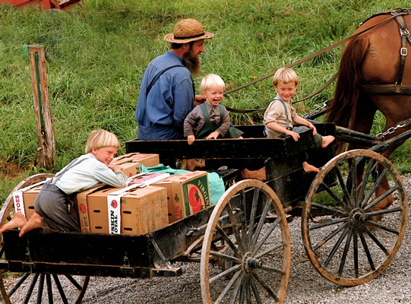
Diffusion of Folk Cultures
The Amish: Relocation Diffusion of Folk Culture
Distinctive clothing, farming, religious practices, and other customs
Amish customs illustrate how relocation diffusion distributes folk culture
Diffused their culture through migration
Living in rural and frontier settlements that are relatively isolated from other groups → Amish communities retained their traditional customs
C U L T U R E
N
O
N
M
A
T
E
R
I
A
L

Slide 4
Assimilation
The process of people losing culture traits when they come into contact with another society or culture
Often used to describe immigrant adaptation to destination culture
The opposite of sustaining local culture
Examples?
United States and Indians
Dawes Severalty Act, 1887
Australia and Aboriginals
Government took children out of homes and placed in residential schools, 1800s-1960s
Parliament officially apologized in 2008

Slide 5
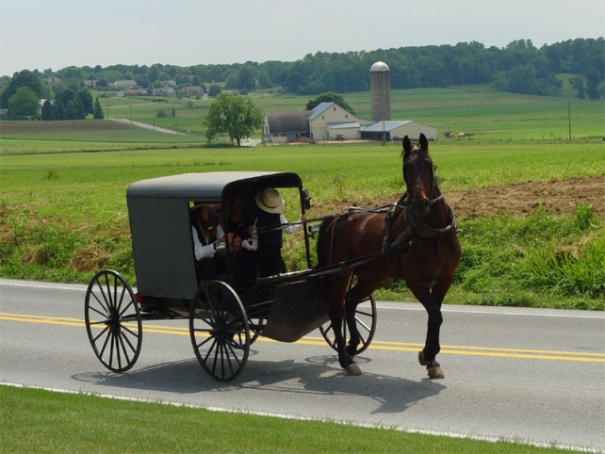
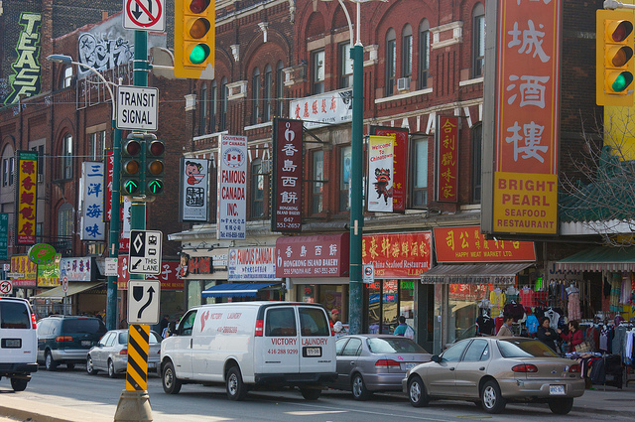
How do local cultures maintain their customs?
Why is it easier for rural local cultures?
More isolated
Examples?
Amish, Mennonites, Hutterites
How can it be done for urban local cultures?
Ethnic neighborhoods
Examples?
Italian Americans: North End of Boston
Chinatowns
Korean Americans: Palisades Park, NJ
Food/religion most likely to sustain
Strive to avoid cultural appropriation

Slide 6
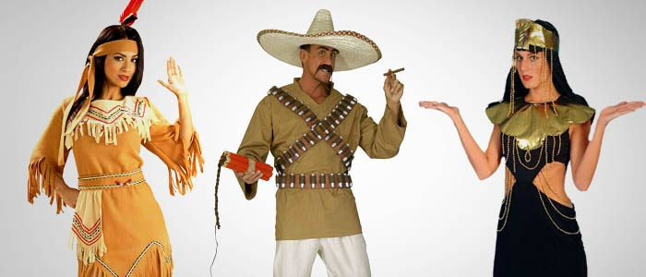
Cultural Appropriation
The process by which cultures adopt customs and knowledge from other cultures and use them for their own benefit.
What was your honest reaction to each of the examples? Is it offensive? Is it funny? Is it cool?
Karly Kloss
Washington Redskins
Lady Gaga
Katy Perry
Kreayshawn
Macklemore
Miley Cyrus

Slide 7
Cultural Appropriation: Perspectives
Which of the following best reflects your perspective on this topic?
Cultural appropriation is harmful perpetuation of stereotypes
Cultural appropriation may be offensive if done without collaboration from representatives of the culture being appropriated
“Cultural appropriation” is a form of free expression and should be protected
“Cultural appropriation” is an example of imitation as a form of flattery

Slide 8
Write a statement in support of your position
Consider the strengths and weaknesses of each statement as you hear it; adjust your statement accordingly

Slide 9
Reverse racism?

Slide 10
Original Maori haka

Slide 11
New Zealand All Blacks rugby haka

Slide 12
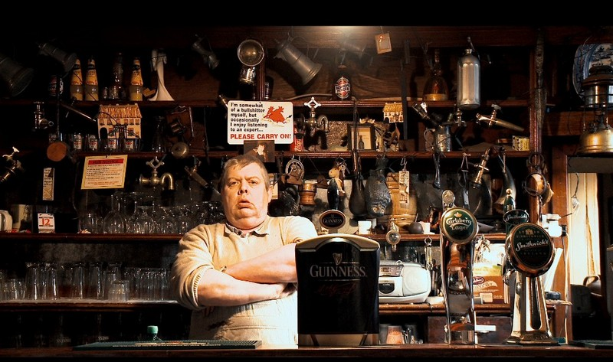

Slide 13
Commodification
Treating a local culture as something to be bought and sold
Material culture
Jewelry, clothing, food, games
Nonmaterial culture
Yoga
Herbal remedies
Can be done by members or nonmembers
Can commodified culture be authentic?
Not if it’s based on stereotypes

Slide 14
Food for thought…
How much, if any, local culture is there in your life?

